Slide 1
Department of Electrical and Computer Engineering NORTH SOUTH UNIVERSITY
Senior Project Design
Group - 03

Slide 2
An Automated Attendance System Using Face Recognition

Slide 3
Group Members:
Shanzida Akter ID # 1520533642
Sumon Mahmud ID # 1521335042
Ariful Islam ID # 1520244042

Slide 4
Why we were decided to create this project
Time consumption
Automatic process
easy to use
Increased Productivity

Slide 5
An Automated Attendance System Using Face Recognition
Problem statements
Problem solution
Cheating in attendance
Time waste
Easily record
Reliable Accuracy
Increased Productivity
Hassle Free Workflow Management

Slide 6
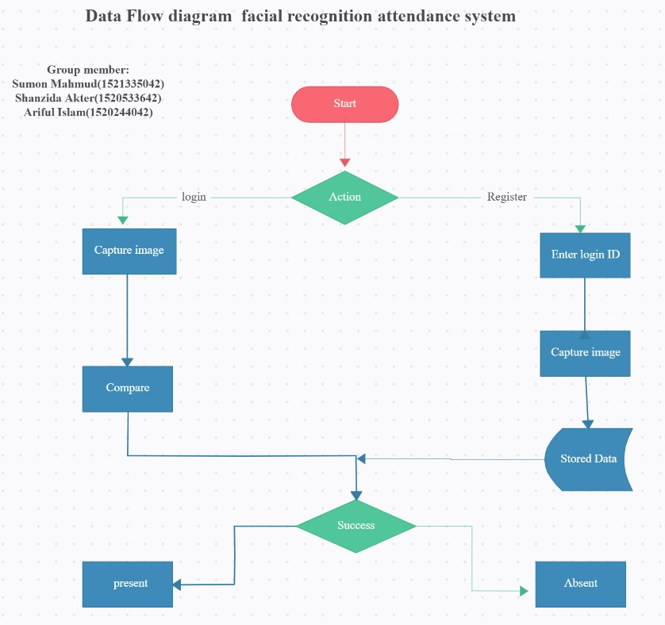

Slide 7
Technical Approach
Software’s and code editors
Hardware
PyCharm(Version 3.7)
Xampp control panel for MySQL database server()
Atom code editor (Atom 1.53.0)
Notepad++ code editor (Notepad++ 7.8.9)
Surveillance camera.
Laptop/Computer.

Slide 8
An Automated Attendance System Using Face Recognition
LANGUAGES-
Python
HTML
CSS
MYSQL
PHP
BOOTSTRAP front-end framework

Slide 9
Insider information
Dataset Collection
Dataset Training
Face Recognition
Python

Slide 10
Insider information
Dataset Collection
Dataset Training
Face Recognition
Python
Open-CV

Slide 11
Insider information
Dataset Collection
Dataset Training
Face Recognition
Python
Open-CV
Cascades classifier

Slide 12
Insider information
Dataset Collection
Dataset Training
Face Recognition
Python
Open-CV
Cascades classifier
Haar Cascades classifier

Slide 13
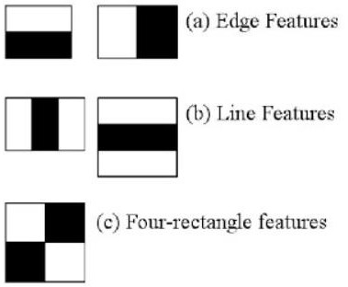
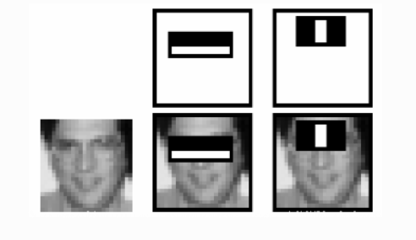
Insider information
Face Detection using Haar Cascades

Slide 14
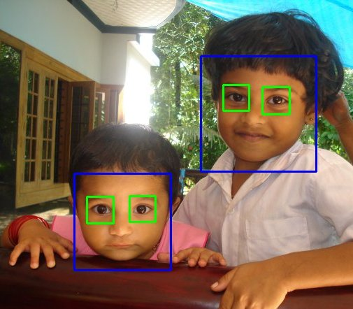
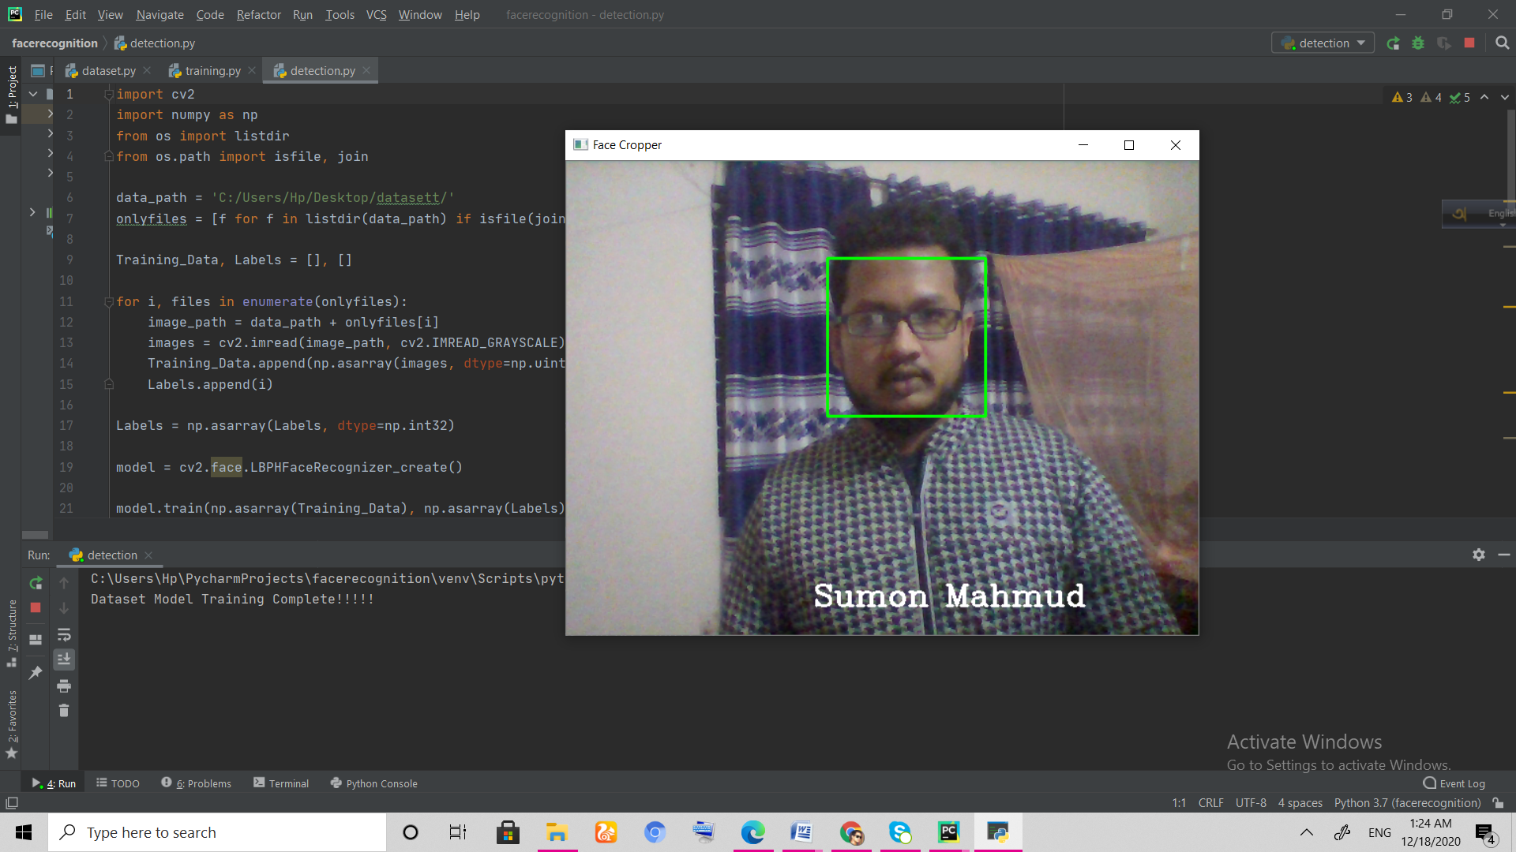
Insider information
Haar-cascade Detection in OpenCV

Slide 15
Insider information
Mysql-connector
Python
MySQL Connector/Python is an API implemented using pure Python. It means that you don’t need to install any MySQL client library or any Python modules except the standard library.

Slide 16
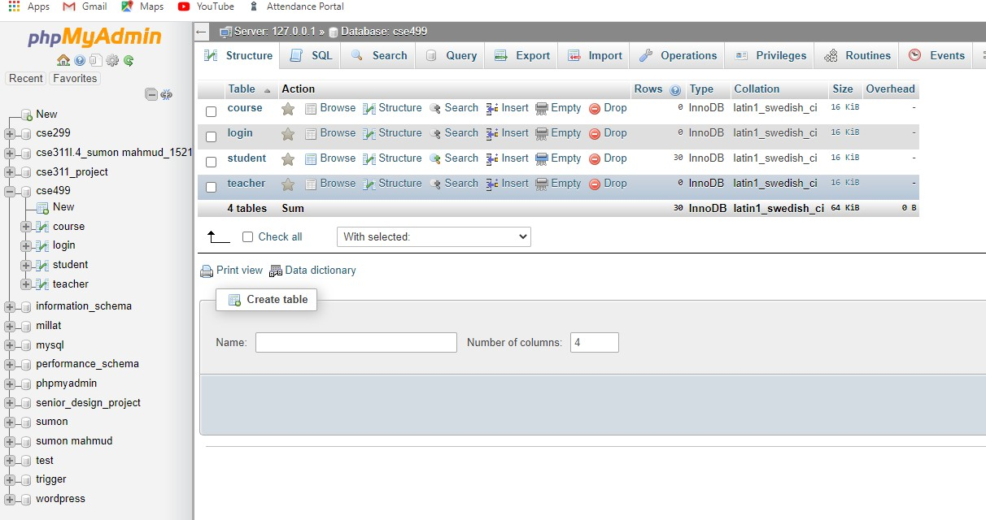
Insider information
Database server

Slide 17
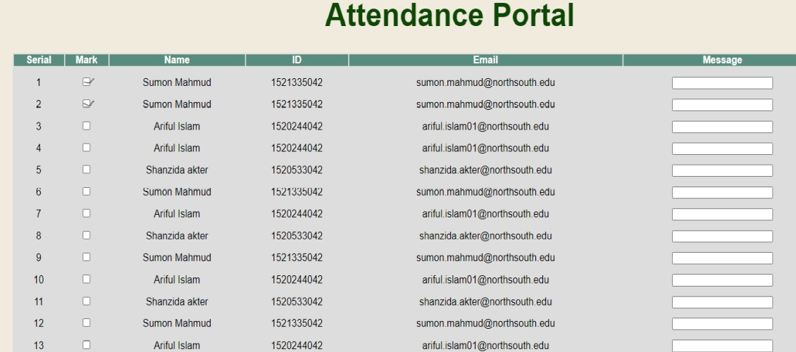
Insider information
Front End

Slide 18
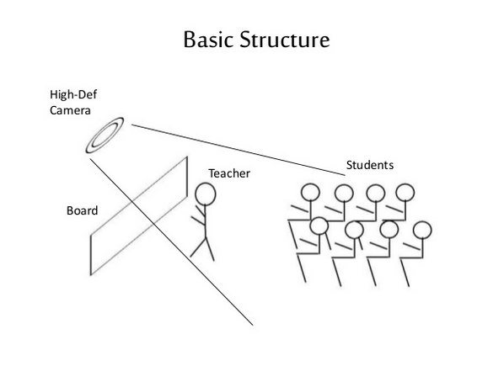
Insider information
Real Time Scenario

Slide 19
Problem faced
Knowing and installing necessary Python packages
Multiple image selection
Light problem in open space
Combined with Haar classifier(path location)
Connecting with database server

Slide 20
Future Work
The whole system of automated attendance for any school, college, industry, company, etc. There will record everyone entry time and out time.
The recognition rate of algorithms when there are unintentional changes in a person like tonsuring head, using scarf, and beard.
The system developed only recognizes face up to 30 degrees angle variations which has to be improved further. Gait recognition can be fused with face recognition systems in order to achieve better performance of the system.
This project to alert the student by sending SMS regarding the attendance. For this purpose GSM module can be used. SMS alert can be given to the parent of the student.

Slide 21
Conclusion
From our experiment, we noticed the face recognition was sensitive to face background, light, and head orientations. This technique described the accurate and efficient method of automatic attendance in the classroom which could replace the traditional method. An automatic attendance has many advantages, most of the existing systems are time consuming and require semi manual interference from lecturers, our system seeks to solve these issues by using face recognition in the process to save the time and labor. And No need for installing complex hardware for taking the attendance in classroom, all we need is a camera and laptop. We used algorithms that can detect and recognize faces in the image.

